Slide 1
Data-Driven Analytics Project
Student Name: Ayush Burman
Batch Code: DA464S46
Project Guide: Komilla Bhatia

Slide 2
Problem Statement
. To make informed decisions in several areas, such as customer relationship management, operational efficiency and cost optimization, product development and procurement, marketing and sales strategies, and inventory management.
. To identify the key factors to improve salesperson performance, streamline order fulfillment, and enhance financial insights.
Objective
Customer Data Analysis
Office Data Analysis
Product Data Analysis
Employee Data Analysis
Order Analysis

Slide 3
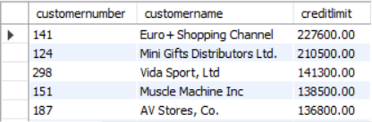
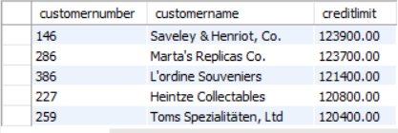
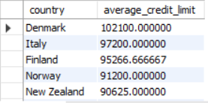
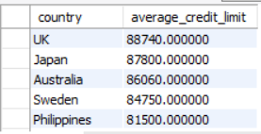
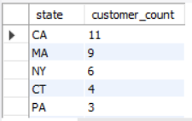
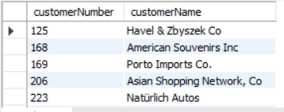
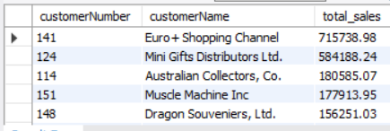
Customer Data Analysis - Insights from the analysis
Interpretation:- Euro+Shopping Channel maintains the highest individual credit limit at $227.6K, followed by Mini Gifts Distributors at $210.5K, indicating these are key high-value accounts. Country-level analysis reveals Denmark has an exceptionally high average credit limit of $1.02M, significantly outpacing other markets like Italy ($97.2K) and Finland ($95.3K).
.
Interpretation:-
The data reveals Euro+Shopping Channel as the top performer with $715.7K in total sales, followed by Mini Gifts Distributors at $584.2K. Geographically, California dominates with 11 customers, while Massachusetts (9) and New York (6) follow. The concentration of high-value customers like Euro+Shopping Channel and strong presence in major markets like CA suggests successful targeting of key accounts and strategic geographic positioning.

Slide 4
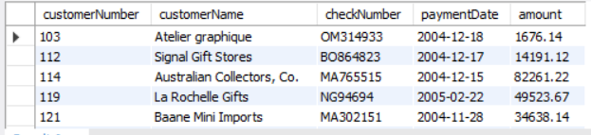
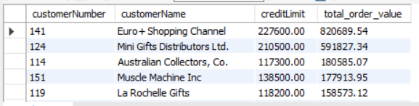
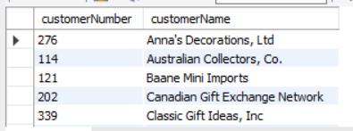
Customer Data Analysis - Insights from the analysis
Interpretation:-
The payment data shows healthy cash flow with recent payments ranging from $1.4K-$49.5K, indicating active customer relationships. However, comparing credit limits to total order values reveals concerning patterns: Euro+Shopping Channel has orders ($820.7K) far exceeding their credit limit ($227.6K), and Australian Collectors shows similar over-extension ($180.6K orders vs $117.3K limit).
Interpretation:-
This appears to be a simple customer directory listing showing five customers with their corresponding numbers and names. The data represents a diverse customer base spanning different business types - from decorations and collectibles to import/export and gift networks.

Slide 5
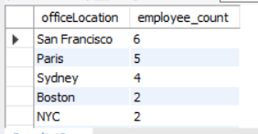
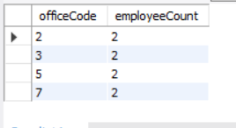
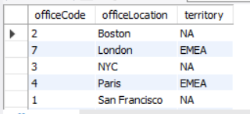
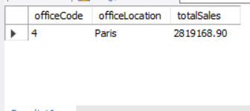
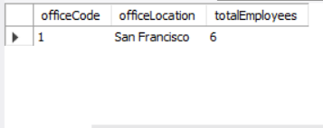
Office Data Analysis - Insights from the analysis
Interpretation:-
The company operates with 19 total employees across 5 locations, with San Francisco as the largest office (6 employees) followed by Paris (5) and Sydney (4). Boston and NYC are smaller operations with 2 employees each. The office code data shows a lean structure with most locations having just 2 employees, suggesting either satellite offices or specialized functions.
Interpretation:-
The company operates across NA and EMEA territories with 5 offices total. Paris significantly outperforms other locations with $2.82M in sales despite having only moderate staffing. The EMEA region (Paris, London) appears to be a key revenue driver, while NA offices (Boston, NYC, San Francisco) serve different strategic functions. San Francisco maintains the largest workforce (6 employees), suggesting it may be headquarters or a major operational center despite limited sales data shown.

Slide 6
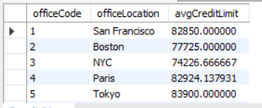
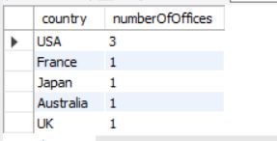
Office Data Analysis - Insights from the analysis
Interpretation:-
The company maintains 7 offices globally with the USA having the highest concentration (3 offices), while France, Japan, Australia, and UK each have single locations. Average credit limits are relatively consistent across offices, ranging from $74K-$84K, with Tokyo having the highest at $84K and NYC the lowest at $74K. The uniform credit distribution suggests standardized risk management policies across all international locations despite geographic diversity.

Slide 7
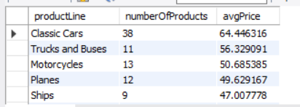
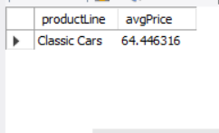
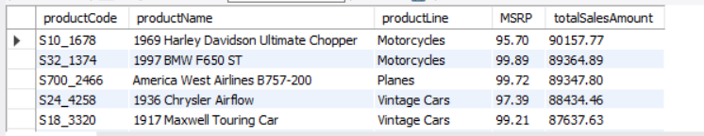
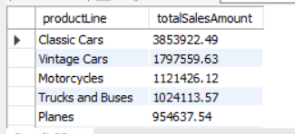
Product Data Analysis - Insights from the analysis
Interpretation:-
Classic Cars dominates the portfolio with 38 products and the highest average price at $64.45, making it the premium product line. The remaining categories show declining price points: Trucks and Buses ($56.33), Motorcycles ($50.69), Planes ($49.63), and Ships ($47.01).
Interpretation:-
Classic Cars generates the highest revenue at $3.86M, followed by Vintage Cars at $1.80M, demonstrating strong demand for automotive collectibles. Individual product performance shows consistent pricing around $95-99 MSRP with strong sales conversion.
The 1969 Harley Davidson leads individual products with $90.2K in sales. Total category performance reveals Classic Cars and Vintage Cars combined account for over $5.6M of the $11.7M total revenue, indicating automotive products drive approximately 48% of total business.

Slide 8
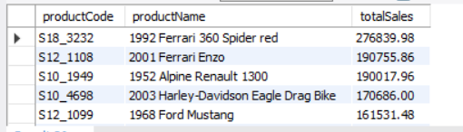
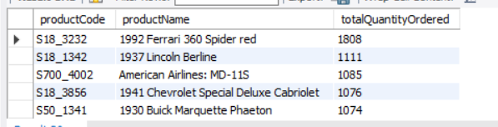
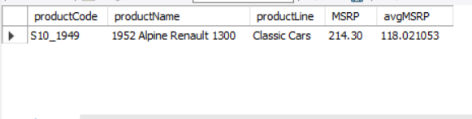
Product Data Analysis - Insights from the analysis
Interpretation:-
The 1992 Ferrari 360 Spider red dominates both sales ($276.8K) and quantity ordered (1,808 units), making it the clear bestseller. Ferrari models show strong performance with the 2001 Enzo also ranking high at $190.8K in sales. Interestingly, high sales revenue doesn't always correlate with high quantity - the Ferrari Spider's exceptional unit sales (1,808) far exceed other top performers like the Lincoln Berline (1,111 units), suggesting varying price points and market demand across different vehicle categories.
Interpretation:-
The 1952 Alpine Renault 1300 shows significant pricing variance with an MSRP of $214.30 but an average selling price of $118.02, indicating either deep discounting strategies, bulk pricing, or potential data inconsistency. This 45% discount from MSRP suggests either aggressive market positioning for this Classic Cars product or possible clearance pricing to move inventory.

Slide 9
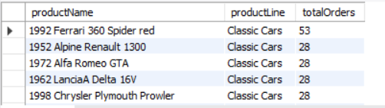
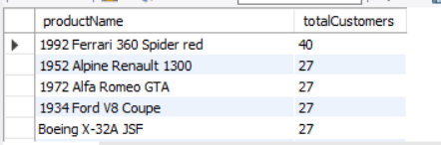
Product Data Analysis - Insights from the analysis
Interpretation:-
The 1992 Ferrari 360 Spider red is the standout performer with $276.8K in sales and 1,808 units ordered, demonstrating exceptional market appeal. Ferrari models dominate sales revenue (Ferrari 360 and Enzo combining for $467.6K), while vintage American models like the Lincoln Berline and Chevrolet Cabriolet show strong quantity demand despite lower individual sales values.
Interpretation:-
The 1992 Ferrari 360 Spider red leads in both total orders (53) and customer reach (40), confirming its position as the flagship product with broad market appeal. Most Classic Cars products show consistent ordering patterns with 28 total orders each, but customer distribution varies - suggesting some customers place multiple orders for certain models.

Slide 10
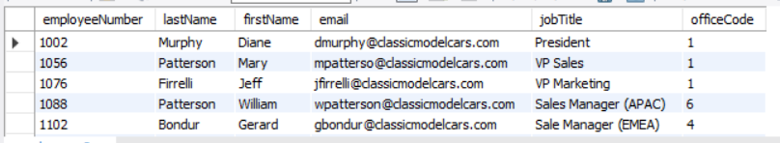
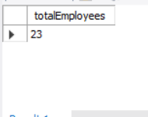
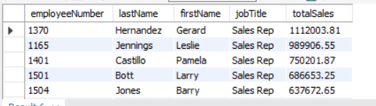
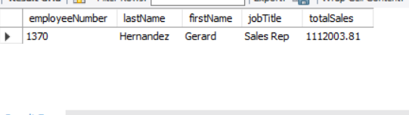
Employee Data Analysis - Insights from the analysis
Interpretation:-
The company employs 23 people total with clear executive structure - Diane Murphy serves as President at the San Francisco office (code 1), supported by VPs Mary Patterson (Sales) and Jeff Firrelli (Marketing). Regional sales management is distributed globally with William Patterson managing APAC from Sydney (office 6) and Gerard Bondur handling EMEA from Paris (office 4). This structure reflects the company's international presence with centralized leadership and regional sales expertise.
Interpretation:-
Gerard Hernandez leads the sales team with $1.12M in total sales, followed by Leslie Jennings at $989K and Pamela Castillo at $750K. All five employees shown are Sales Representatives, indicating a strong focus on direct sales execution. The performance range spans from $637K (Barry Jones) to $1.12M (Gerard Hernandez), showing a 76% variance between top and bottom performers, suggesting opportunities for training standardization or territory optimization to improve overall team consistency.

Slide 11
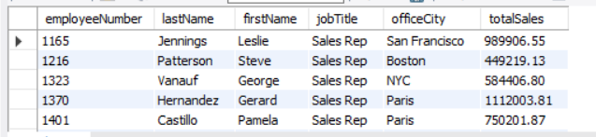
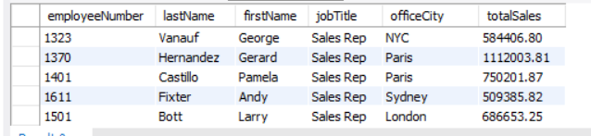
Employee Data Analysis - Insights from the analysis
Interpretation:-
Sales performance varies significantly by office location, with Paris-based reps (Gerard Hernandez $1.12M, Pamela Castillo $750K) leading in revenue generation. Leslie Jennings in San Francisco performs well at $989K, while other locations show mixed results - NYC's George Vanauf at $584K, Boston's Steve Patterson at $449K, and London's Larry Bott at $637K. The Paris office's exceptional performance suggests either stronger market conditions, better territory management, or superior local expertise in the EMEA region.

Slide 12
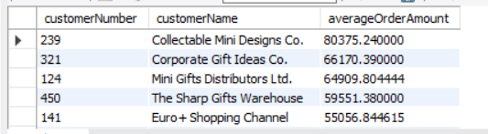
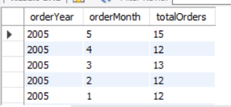
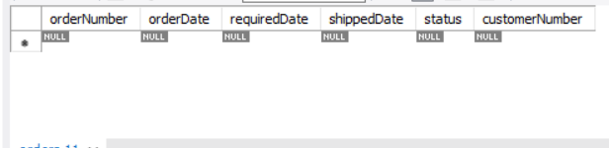
Order Analysis - Insights from the analysis
Customer Purchase & Payment Analysis
Interpretation:- Collectable Mini Designs Co. leads with the highest average order value at $80.4K, followed by Corporate Gift Ideas at $66.2K, indicating strong high-value B2B relationships. Mini Gifts Distributors ($64.9K), The Sharp Gifts Warehouse ($59.6K), and Euro+Shopping Channel ($59.1K) show relatively consistent mid-range ordering patterns.
Order Trends and Processing
Interpretation:-
Order volume in 2005 shows seasonal variation with May having the highest activity (15 orders) while other months maintain steady levels around 12-13 orders. The consistent monthly performance from January through April suggests stable demand. The right panel shows null values across all order processing fields, indicating either data quality issues or incomplete order tracking system implementation.

Slide 13
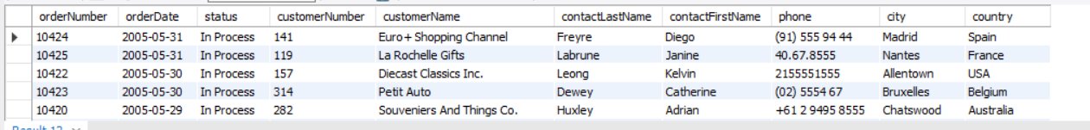
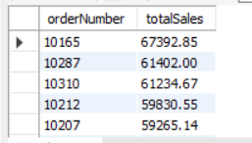
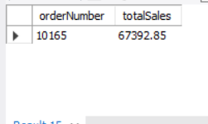
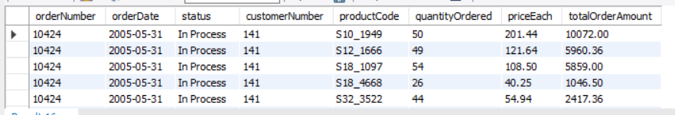
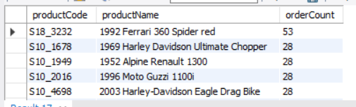
Order Analysis - Insights from the analysis
Interpretation:- All orders from May 29-31, 2005 show "In Process" status, indicating potential processing delays or backlog issues during this period. The customer base spans multiple countries (Spain, France, USA, Belgium, Australia) demonstrating strong international reach. Notable customers include Euro+Shopping Channel and La Rochelle Gifts.
Sales & Revenue Analysis
Order Details with Product & Pricing​ & Most Ordered Products: Order values range from $59.3K to $67.4K with order 10165 leading at $67.4K total sales. The detailed breakdown shows Euro+Shopping Channel (customer 141) placing a substantial single order on 2005-05-31 with multiple product lines including 50 units of the 1952 Alpine Renault at $201.44 each. The above charts indicate strong demand concentration in premium Ferrari products.

Slide 14
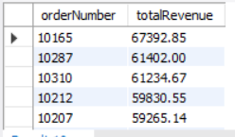
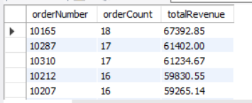
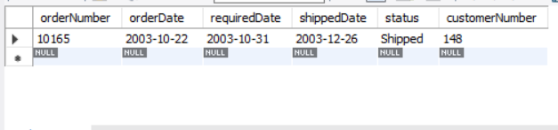
Order Analysis - Insights from the analysis
Interpretation:- Order 10165 generates the highest revenue at $67.4K with 18 line items, indicating a large, diverse purchase. The correlation between order count and revenue is strong - higher line item counts (16-18) correspond to higher revenues ($59K-$67K). The data suggests successful upselling with larger orders (more line items) driving proportionally higher total revenues.
Interpretation:- Euro+Shopping Channel's order 10424 (May 31, 2005) shows diverse product purchasing across multiple lines - Classic Cars, Trucks and Buses, and Vintage Cars - with quantities ranging from 26-50 units and prices from $40.25-$201.44. All items remain "In Process," suggesting active fulfillment. Order 10165 indicates normal seasonal processing during peak periods.

Slide 15
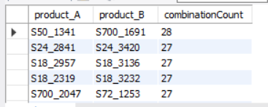
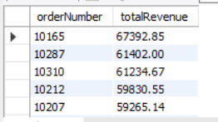
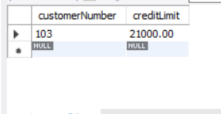
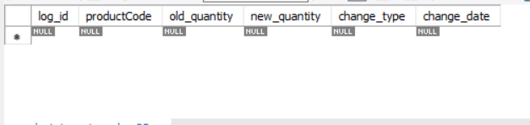
Order Analysis - Insights from the analysis
Product Demand & Customer Buying Patterns​
Interpretation:-
The data reveals strong product bundling patterns with customers frequently purchasing specific product combinations. The top combination (S50_1341 and S700_1691) appears in 28 orders, while three other pairs each appear in 27 orders, indicating consistent cross-selling success.
Inventory & Credit Limit Management​
Interpretation:- Customer 103 has a $21,000 credit limit, but the inventory tracking system shows significant data quality issues with all fields (log_id, productCode, old_quantity, new_quantity, change_type, change_date) returning null values. This indicates either incomplete inventory management system implementation or data integration problems that could impact stock level monitoring and automated reordering processes.

Slide 16
Summary
(1) Euro+Shopping Channel leads with $715.7K in sales but has concerning over-extension ($820.7K orders vs $227.6K credit limit), while Denmark shows the highest average credit limits at $1.02M. The customer base spans diverse business types with strong geographic concentration in California (11 customers) and healthy recent payment activity ranging $1.4K-$49.5K.
(2) The company operates 19 employees across 5-7 offices globally, with San Francisco as the largest office (6 employees) and Paris as the top revenue performer ($2.82M in sales). Credit limits are consistently managed at $74K-$84K across all international locations, with the USA having the highest office concentration (3 locations) while EMEA serves as the key revenue driver.
(3) Classic Cars dominates with 38 products at $64.45 average price generating $3.86M revenue, with the 1992 Ferrari 360 Spider red as the standout performer ($276.8K sales, 1,808 units). Automotive collectibles (Classic + Vintage Cars) drive 48% of total business at $5.6M of $11.7M revenue, while some products show significant pricing variance like the Alpine Renault selling 45% below MSRP.
(4) The company employs 23 people with Diane Murphy as President in San Francisco and regional VPs/managers across global offices, while Gerard Hernandez leads sales performance at $1.12M followed by Leslie Jennings at $989K. Paris-based sales reps significantly outperform other locations, with a 76% variance between top ($1.12M) and bottom ($449K) performers indicating opportunities for training standardization and territory optimization.

Slide 17
Summary
(5) Collectable Mini Designs Co. leads with $80.4K average order value while Euro+Shopping Channel shows strong international reach with diverse product purchases, though May 2005 orders show "In Process" backlogs indicating processing delays. The analysis reveals successful product bundling with top combinations appearing in 27-28 orders, but significant data quality issues exist with null inventory tracking fields suggesting incomplete system implementation.

Slide 18
Conclusion
Euro+Shopping Channel and Australian Collectors are operating significantly above their approved credit limits and require immediate review. Euro+Shopping Channel has accumulated $820.7K in orders against a $227.6K credit limit (360% over-extension), while Australian Collectors shows $180.6K in orders versus a $117.3K limit (154% over-extension). Despite Euro+Shopping Channel being our top performer with $715.7K in sales and maintaining healthy payment activity ($1.4K-$49.5K recent payments), these over-extensions create substantial financial exposure that could impact cash flow and increase bad debt risk if not addressed promptly through credit limit increases or payment acceleration.
Paris office shows exceptional sales productivity, generating $2.82M in revenue with only 5 employees, resulting in approximately $564K in sales per employee. This significantly outperforms the company's resource allocation model, especially when compared to San Francisco which maintains the largest workforce (6 employees) but serves primarily operational functions rather than direct revenue generation.
The company should focus on expanding the Ferrari product line and investigating the Alpine Renault pricing anomaly to optimize profitability. Ferrari models demonstrate exceptional performance with the 1992 Ferrari 360 Spider red generating $276.8K in sales (1,808 units) and combined Ferrari models contributing $467.6K in revenue, indicating strong premium market demand.
The company should implement a comprehensive performance improvement program focused on replicating the Paris office's success model across all locations. Gerard Hernandez ($1.12M) and Pamela Castillo ($750K) in Paris significantly outperform representatives in other offices, with Boston's Steve Patterson at only $449K representing the largest performance gap. The company should conduct knowledge transfer sessions where Paris-based reps share best practices, standardize sales training programs based on the EMEA region's successful approaches, and consider territory rebalancing to ensure equitable opportunity distribution.
2. 3. 4.

Slide 19
Conclusion
5. The company needs immediate action on two critical operational issues: order processing delays and inventory system integration. All orders from May 29-31, 2005 show "In Process" status, indicating a significant backlog during peak seasonal demand (May had 15 orders vs. 12-13 in other months), which could damage relationships with key international customers like Euro+Shopping Channel. The company should implement automated order processing workflows to handle seasonal spikes, establish backup processing procedures for peak periods, and immediately address the inventory system integration problems to ensure real-time stock visibility. These improvements are critical given the strong product bundling patterns (top combinations appearing in 27-28 orders) and high-value orders averaging $59K-$67K that require reliable fulfillment.

Slide 20
THANK YOU

